Slide 1
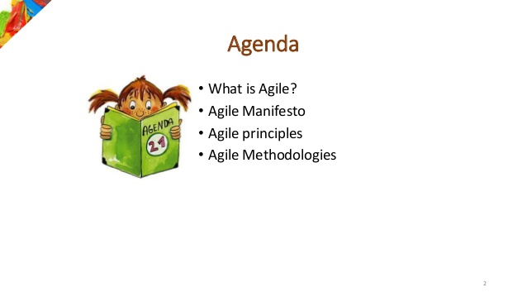
Agile –Overview

Slide 2
A-gil-i-ty (ә-'ji-lә-tē) Property consisting of quickness, lightness, and ease of movement; To be very nimble
The ability to create and respond to change in order to profit in a turbulent business environment
The ability to quickly reprioritize use of resources when requirements, technology, and knowledge shift
A very fast response to sudden market changes and emerging threats by intensive customer interaction
Use of evolutionary, incremental, and iterative delivery to converge on an optimal customer solution
Maximizing BUSINESS VALUE with right sized, just enough, and just-in-time processes and documentation

Slide 3
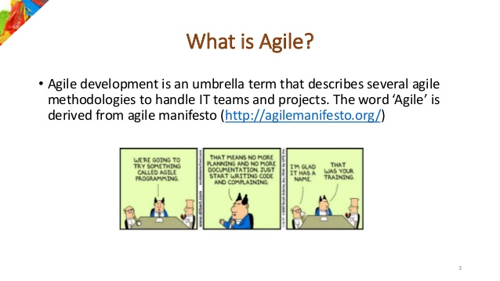

Slide 4
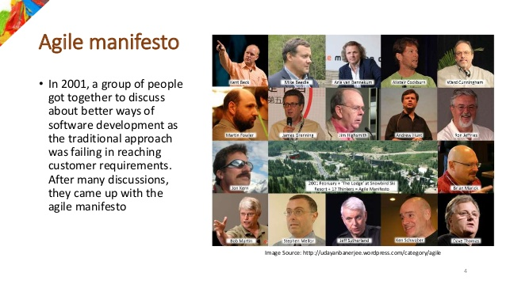

Slide 5
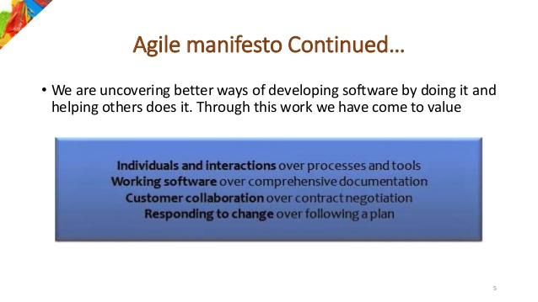

Slide 6
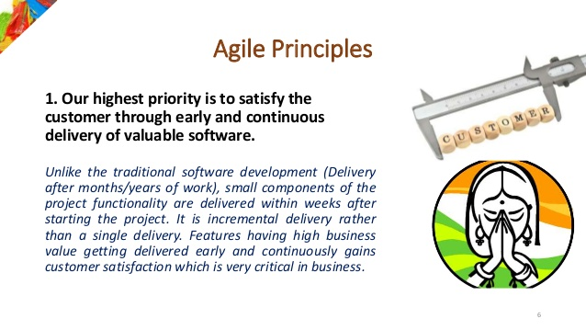

Slide 7
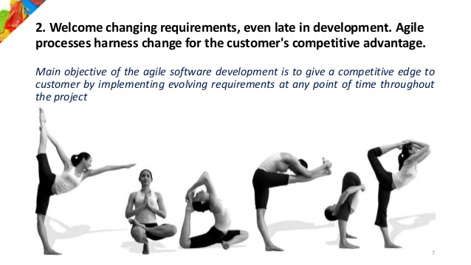

Slide 8
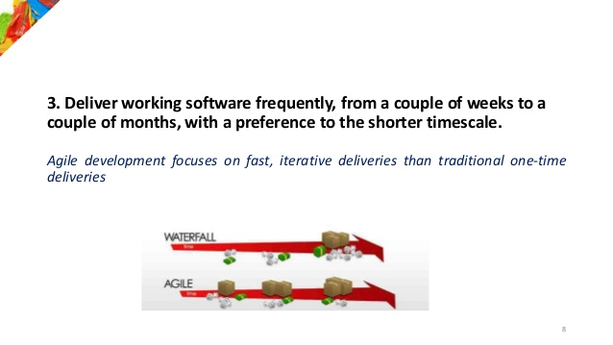

Slide 9
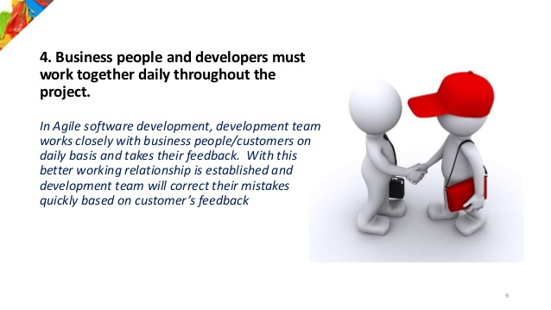

Slide 10
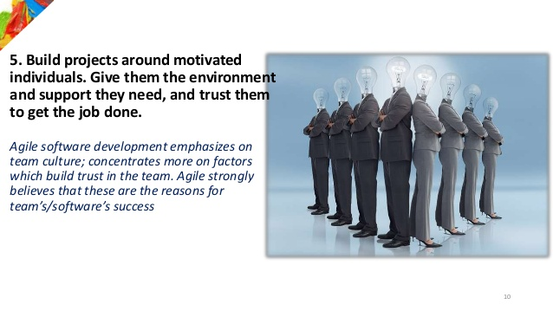

Slide 11
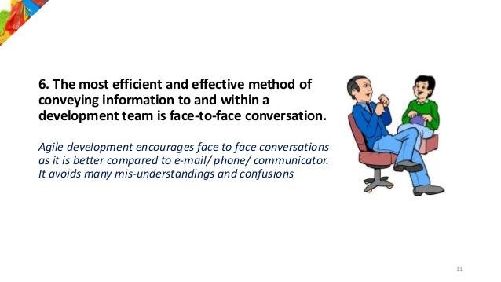

Slide 12
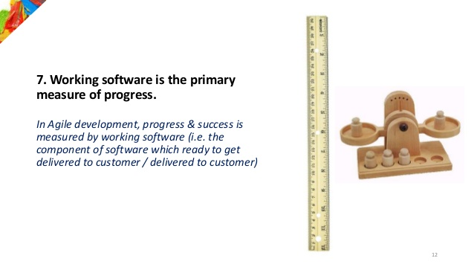

Slide 13
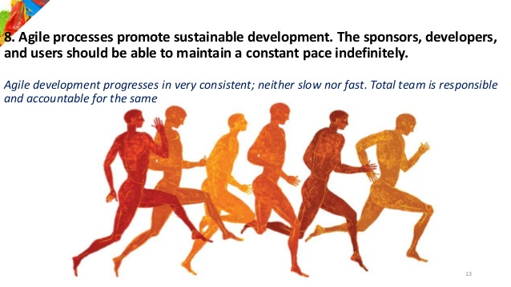

Slide 14
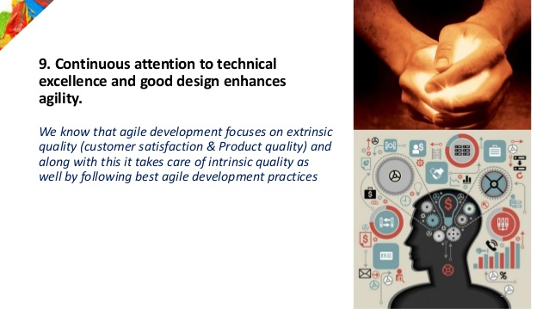

Slide 15
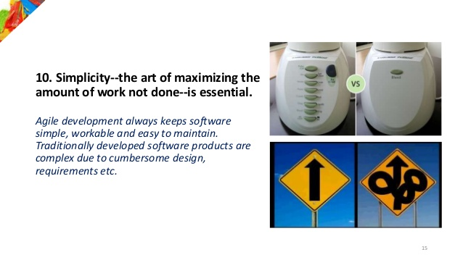

Slide 16
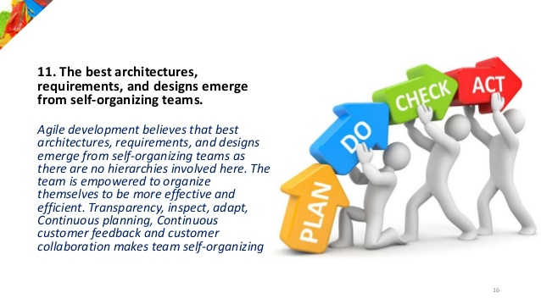

Slide 18
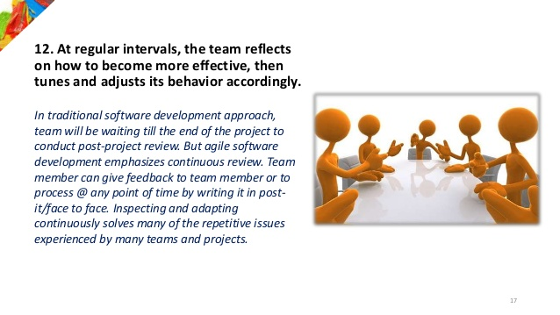

Slide 19
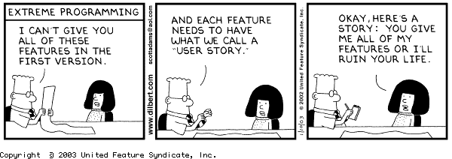

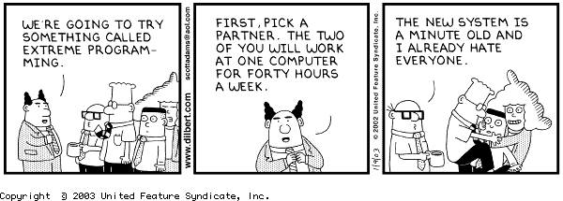
Agile Misconceptions?
Agile means: “letting the programming team do whatever they need to with no project management, and no architecture, allowing a solution to emerge, the programmers will do all the testing necessary with Unit Tests…”

Slide 20
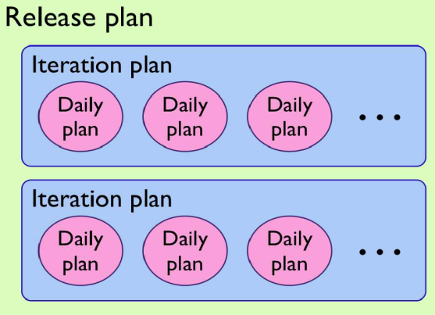

Myth 1: Agile Means No Planning/ Documentation
Actually there are multiple levels of planning
Daily planning
Bi-weekly Sprint planning
Release Planning every 3 – 4 months
Agile does, in fact, produce documentation, even though it differs from that of Waterfall.
Increased collaboration throughout Agile development projects provides all stakeholders with a better understanding of the end product as it is being created, thus reducing the need for some design documentation.
For example, rather than create a single, lengthy document listing all project requirements, project managers might compile a collection of user stories that can be actively updated and maintained using software, prioritized on the fly, and used to provide real-time visibility into development progress.

Slide 21

Myth 2: Agile is a silver bullet solution!
Proponents of agile will sometimes claim that moving to agile will “fix all of your problems”.
That is not the case.
Agile Values and Principles point to Collaboration, Rapid Feedback Loops, and Quality.
In this way, agile exposes your problems - before any issue can be addressed, it needs to be surfaced.

Slide 22

Myth 3: Agile Projects don’t use Project Managers
It is true Scrum doesn’t discuss Project Managers – it focuses on the Product Owner, Scrum Master, and the Development Team.
Project Managers typically have different responsibilities, such as budgeting, reporting, and portfolio management.
In projects using Scrum, these tasks are often split up between the product owner and scrum master.
Project Managers will often take the scrum master role and then train the product owners

Slide 23
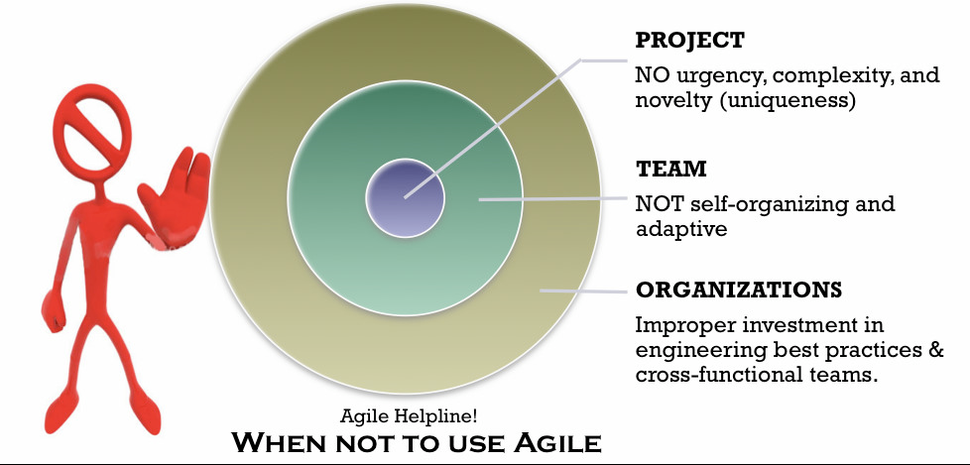
Myth 4: Agile can be used for all/any software development
Not recommended for systems where human life is on the line.
NASA

Slide 24
Myth 5: Agile = Anarchy
Some managers believe that self-organization is the same as anarchy
A self organized team is a group of motivated individuals, who manage their work (allocation, reallocation, estimation,, delivery, and rework) as a group.
They still require mentoring and coaching, but they don't require "command and control."
Management role does change
They provide care and feeding
They define clear vision and constraints
Not responsible for delivery
It is only within this confines does self-organization happen

Slide 25
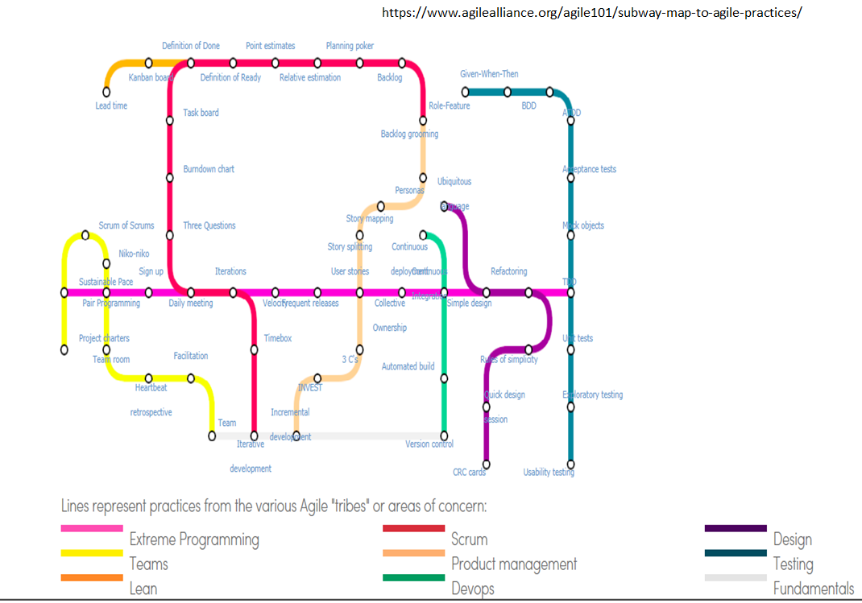
Myth 6: There’s only one way to do Agile
The Agile Manifesto consists of four values and 12 principles.
Each style has benefits, as well as weaknesses, and one must evaluate their own specific situation to determine which interpretation is the best match.
As long as you are adhering to the Agile Manifesto’s values and principles, you should be considered agile.

Slide 26
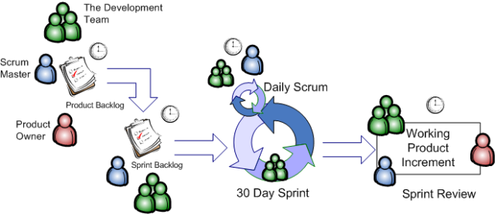
Myth 7: Agile processes are less disciplined and structured than those of waterfall.
Successful Agile implementations are more process-driven and coordinated than traditional waterfall implementations.

Slide 27
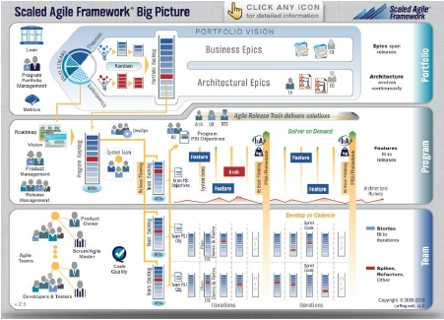
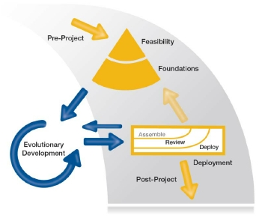
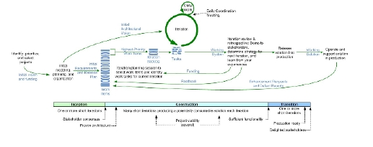
Myth 8: Agile only works for small projects….
DSDM
www.dsdm.org
SAFe
www.scaledagileframework.com
DAD
https://www.ibm.com/developerworks/community/blogs/ambler/entry/dis
ciplined_agile_delivery_dad_lifecycle14?lang=en
33

Slide 28
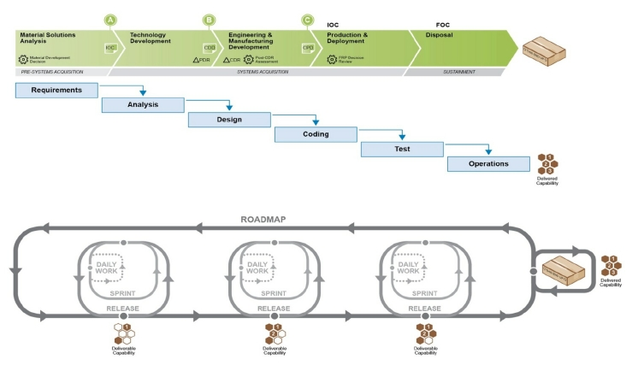
Myth 9: Agile is just incremental, or spiral, or
iterative, renamed
Fixed Vision
Evolving Vision
Source: Palmquist, Steven; Lapham, Mary Ann; Garcia-Miller, Suzanne; Chick, Timothy; & Ozkaya, Ipek. Parallel Worlds: Agile and Waterfall Differences and Similarities
(CMU/SEI-2013-TN-021). Software Engineering Institute, Carnegie Mellon University, 2013.
.

Slide 29
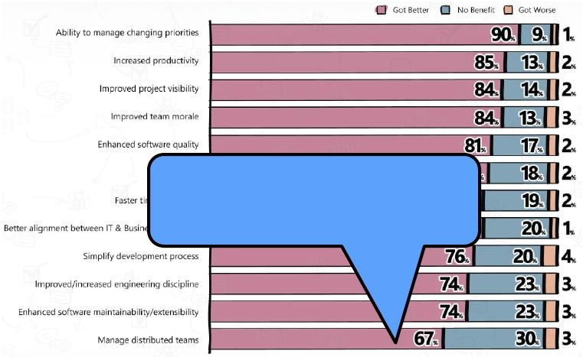
Myth 10: Agile Only Works in Co-Located
Environments
67% of Version One survey
respondents say managing
distributed teams was better when
using Agile.

Slide 30
Benefits of Agile Methodology for developers and for business

Slide 31
Continuous Delivery
Our highest priority is to satisfy the customer through early and continuous delivery of valuable software
Sustainable process
Feature boxed

Slide 32
Changing Requirements
Welcome changing requirements, even late in development. Agile processes harness change for the customer's competitive advantage
Particularly appropriate for situations with volatile requirements

Slide 33
Frequent Delivery
Deliver working software frequently, from a couple of weeks to a couple of months, with a preference to the shorter timescale
Very small increments
Implies increased release overhead

Slide 34
Customer Involvement
Business people and developers must work together daily throughout the project
Implies identified customer (or surrogate)
And big-time customer commitment
Suitable for in-house projects

Slide 35
Motivated Participants
Build projects around motivated individuals. Give them the environment and support they need, and trust them to get the job done
All processes want motivated individuals
Agile office design

Slide 36
Meetings
The most efficient and effective method of conveying information to and within a development team is face-to-face conversation.
Questionable
Have to identify who should be attending

Slide 37
Software Focus
Working software is the primary measure of progress
De-emphasis of infrastructure, both architectural and process
Due to developer and user’s constant communication, it’s possible to deliver the features that provide the most business values.

Slide 38
Sustainability
Agile processes promote sustainable development. The sponsors, developers, and users should be able to maintain a constant pace indefinitely
All processes would like this
No crises requiring overtime

Slide 39
Amortization
Continuous attention to technical excellence and good design enhances agility
Amortization of design and quality activities throughout development
Localizes design decisions

Slide 40
Simplicity
Simplicity--the art of maximizing the amount of work not done--is essential
Avoid generalizing

Slide 41
Self Organization
The best architectures, requirements, and designs emerge from self-organizing teams.

Slide 42
Reflection
At regular intervals, the team reflects on how to become more effective, then tunes and adjusts its behavior accordingly
Amortization of process

Slide 43
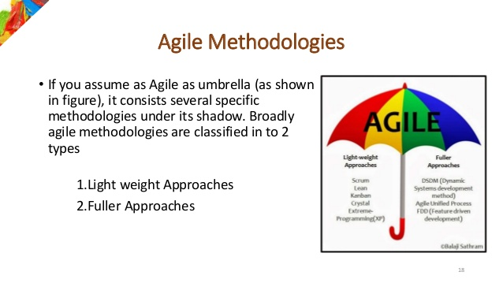

Slide 44
Tool set for Agile Process
Light weight Approaches-
SCRUM,
Lean,
Kanban,
Crystal,
Xtreme Programming( XP)
Fuller Approaches-
DSDM ( dynamic systems development method),
Agile Unified Process,
Feature-Driven Development,
Pragmatic Programming ,
Adaptive Software Development

